Slide 1
Accented Voice Recognition Guidelines
By Jeremy Fehr
CMPT 480
December 1, 2019

Slide 2
Justification
Long-standing problems with accents for automated speech recognition.
Most research goes toward accommodating specific accents; there is no broad solution.
Accents are constantly evolving.
Forces users to adopt a new accent.

Slide 3
Algorithmic Analysis
New advances are using machine learning to improve specific accents.
Interpreting natural language is incredibly complex.
Accommodating many accents isn’t currently feasible.
Michael Tjalve’s from University College London’s PHD thesis outlined many of the challenges.

Slide 4
Linguistic Analysis
Most researches aren’t considering linguistics as part of their research.
Considering linguistics can simplify the problem.
Peter Ladefoged researched universal qualities behind many of the world’s languages.

Slide 5
Implementation
Researched various solutions for specific accents in speech recognition systems.
Difficult to distinguish between general and specific solutions.
A lot of very technical and advanced research.
No system to test my guidelines.

Slide 6
Implementation
Convert universal principles of spoken language into guidelines for speech recognition systems.
Used references from the Linguistics Department.
These were the most useful.
Heavily referenced the fields of Phonetics and Phonology.

Slide 7
Results
20 guidelines were written under 4 categories:
Universally distinct words
Ease of pronunciation
User comprehension
System characteristics

Slide 8
Results: Universally Distinct Words
The largest category of guidelines.
Uses sounds that are stable across accents.
Difficult to evaluate the results.
Advanced algorithms would be needed to measure the similarity between words.
Linguistic theory was used to evaluate these results.

Slide 9
IPA Vowel Chart (alt slide)
28 vowels are sorted within an inverted trapezoid shape. Columns are sorted by front, central, and back; and rows are sorted by close, close-mid, open-mid, and open.

Slide 10
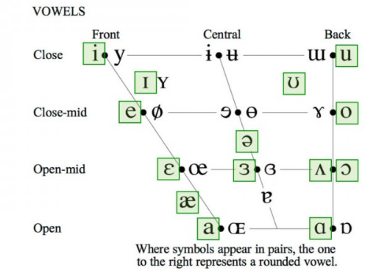

Slide 11
Results: Ease of Pronunciation
Guidelines give advice on avoiding difficult English words.
Identifies sounds and words that more people around the world are likely to easily produce.
Results don’t deviate far from well documented research.

Slide 12
Results: User Comprehension
Some English words have different meanings around the world.
Avoids regional variants.
Aims for “simple English”.
Needs more thorough research. Simplicity is somewhat relative.

Slide 13
Results: System Characteristics
Guidelines to specifically benefit the speech recognition system.
These will benefit users indirectly.
More easily evaluated by computer science standards.

Slide 14
Conclusion
More practical evaluation is needed. It is too theoretical.
Worth pursuing for someone in the field of computational linguistics.
This is a unique approach to improving accented voice recognition.

